Slide 1

Binary Coded Hexadecimal to Seven-Segment Display EE648: VLSI Design Dr. Jason McNeely
May 1, 2017
Ryker Dial, Cody Gossel, and Zach Krehlik

Slide 2
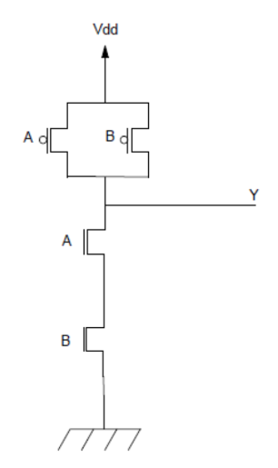
Overview
Introduction
What
Why
Design
Gate level logic
Transistor layout
Testing and Results

Slide 3
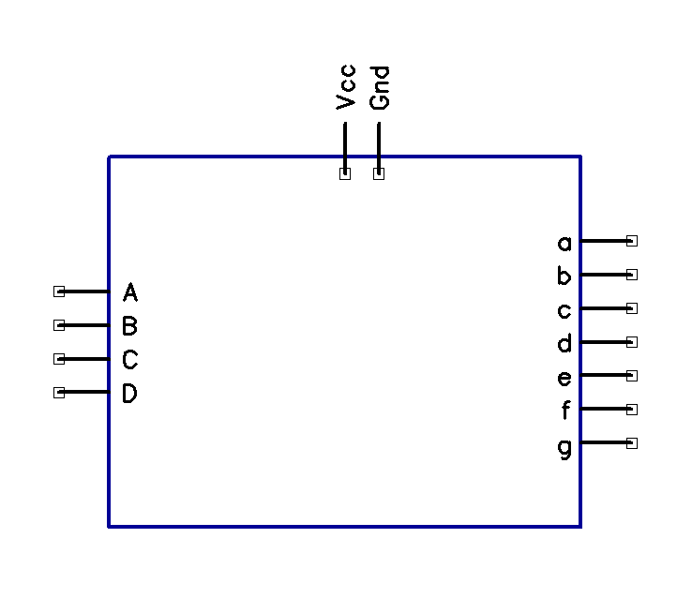
Introduction
Output a single hexadecimal digit equivalent of a 4-bit binary number
Logic schematics using NAND gates and inverters

Slide 4
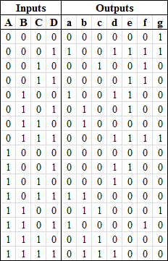
Design
Truth Table for each of the seven segments in the display
Determine logic equations for each segment

Slide 5
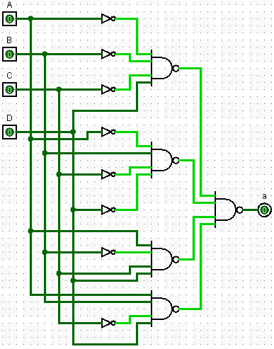

Design
Truth Table for each of the seven segments in the display
Determine logic equations for each segment
Convert logic to NAND equivalent
Create gates in Magic

Slide 6
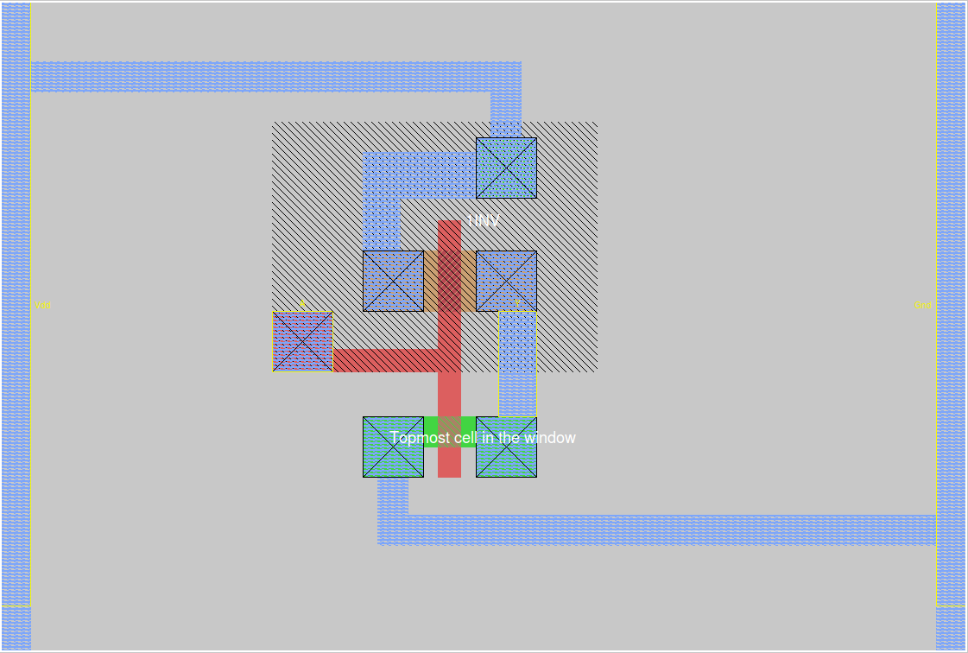
Design - Inverter Layout

Slide 7
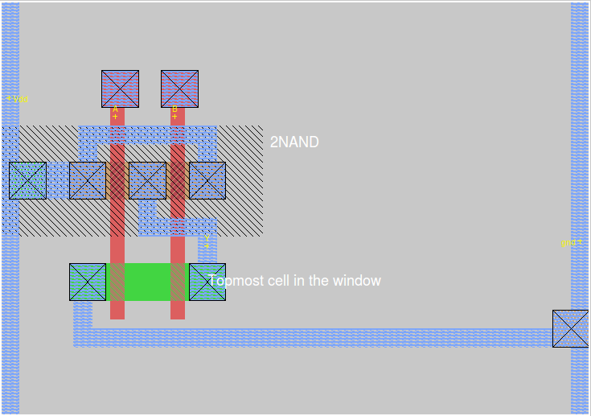
Design - NAND2 Layout

Slide 8
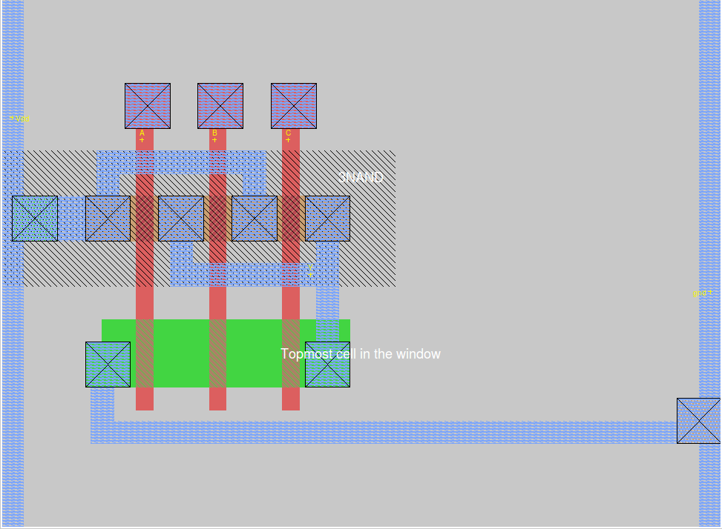
Design - NAND3 Layout

Slide 9
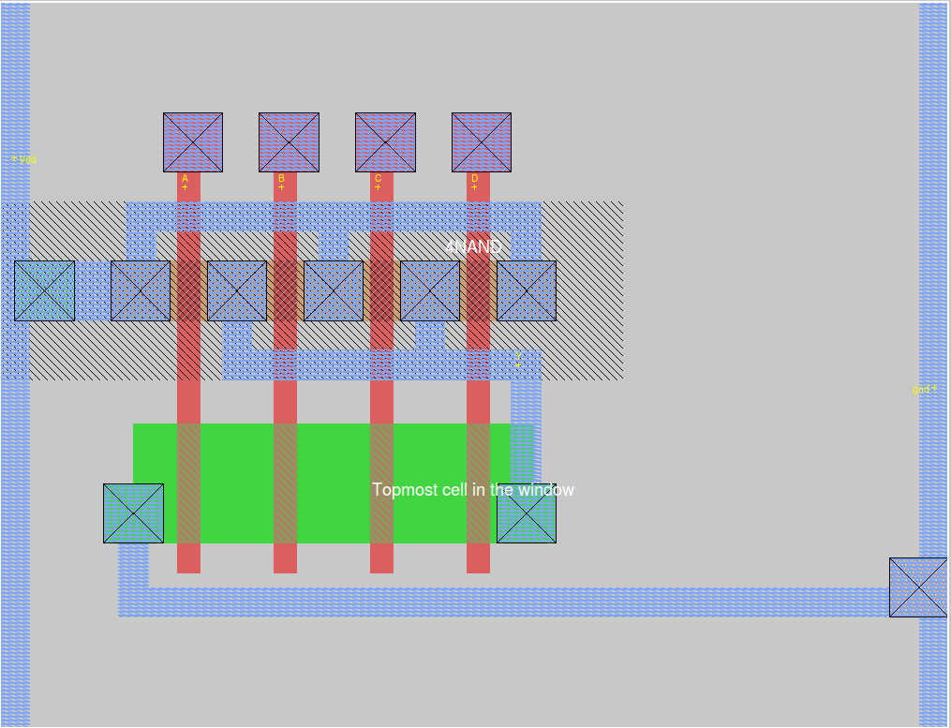
Design - NAND4 Layout

Slide 10
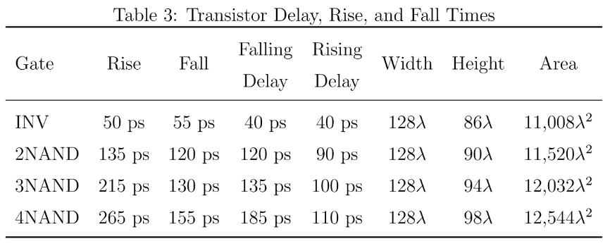
Testing

Slide 11
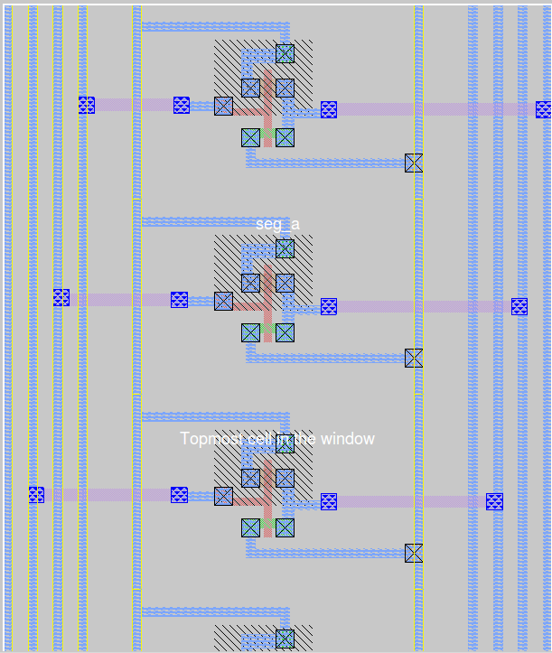
Design – Connecting Gates
After testing individual gates, connect to represent logic for output segments a - g

Slide 12
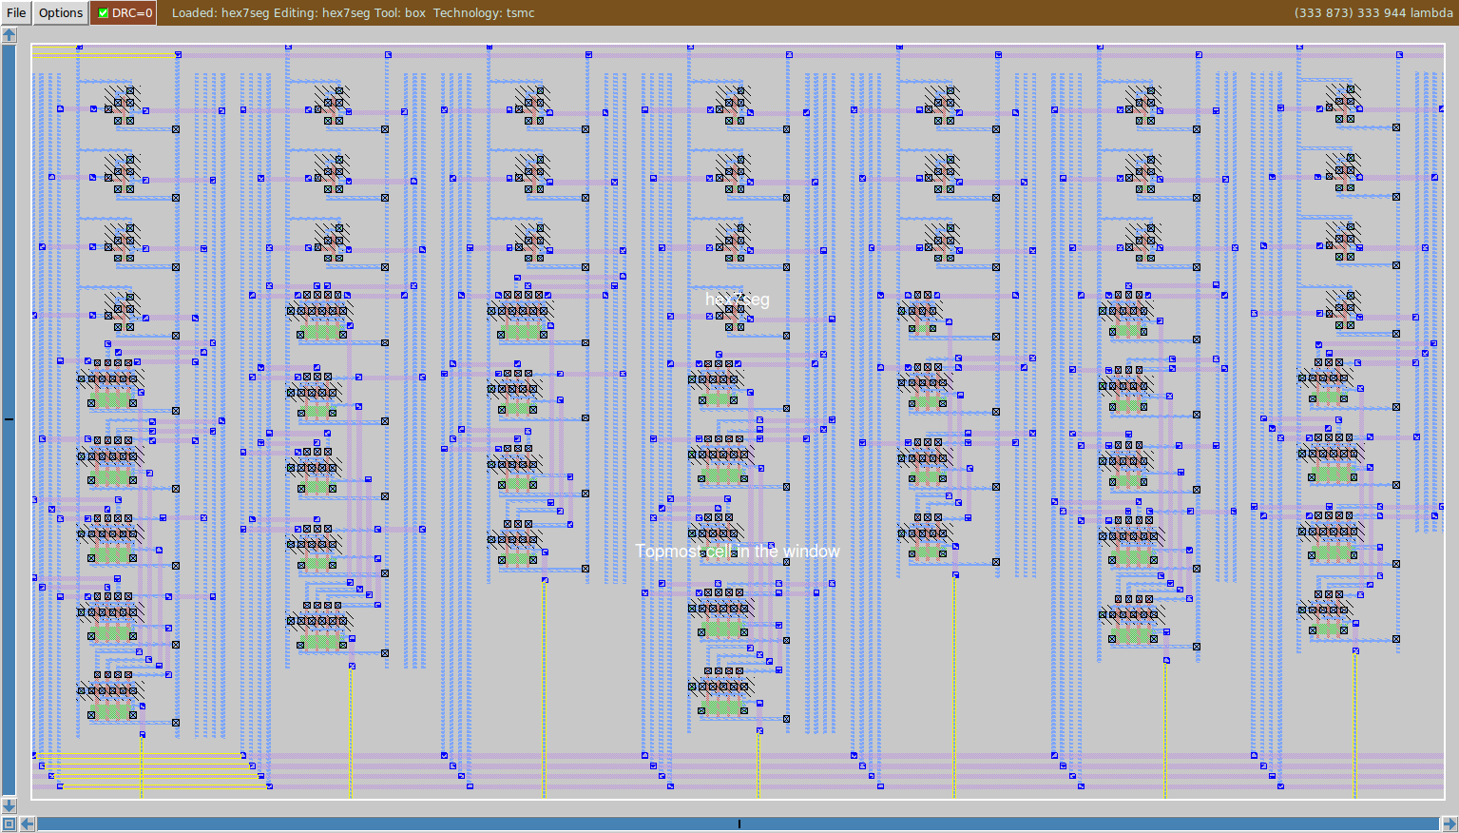
Complete Circuit Layout

Slide 13
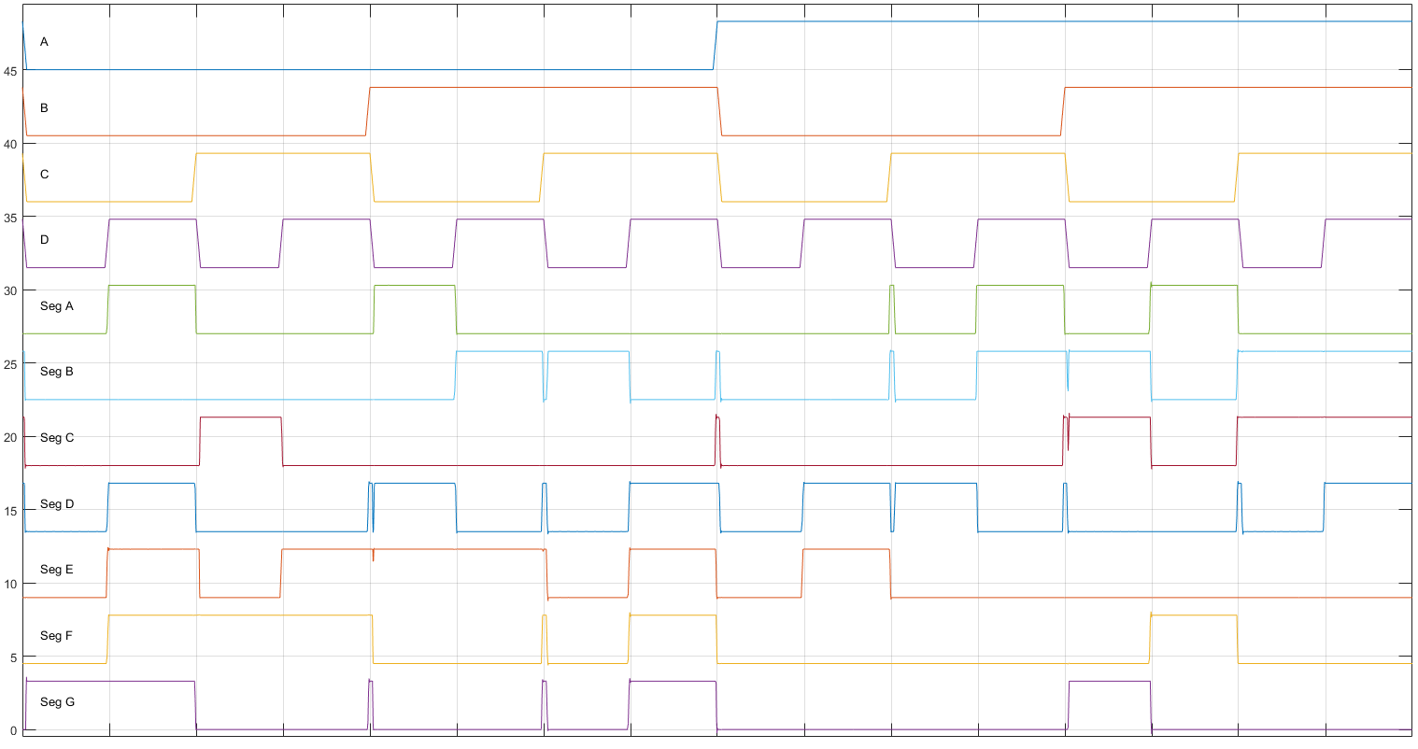
Final Test Results

Slide 14

Acknowledgements
Special thanks to Dr. Jason McNeely for providing guidance, constructive criticism, inspiration and support throughout the design process

Slide 15


Slide 16
Title

Slide 17
Title

